Slide 1
Week 8 Report
Qi Luo, Sidharth Suravarapu
OSHKOSH PROJECT: Assessment of Autonomous Driving Software Performance on Edge Devices

Slide 2
Primary Objectives
1
Implement Autoware on Ambarella edge device
2
Evaluate the capability of the Ambarella devices
3
Compare the performance of Ambarella device to the NVIDIA ORIN

Slide 3
Completed Tasks
Electrical Meter Sockets
Nvidia device and Ambarella system monitors

Slide 4
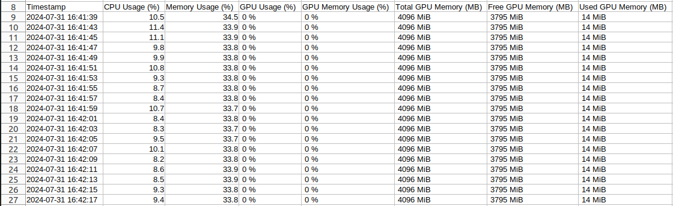
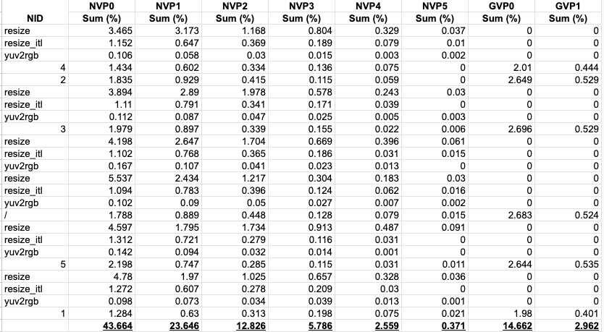
Results
Autoware System Monitor
Nvidia Device System Monitor

Slide 5
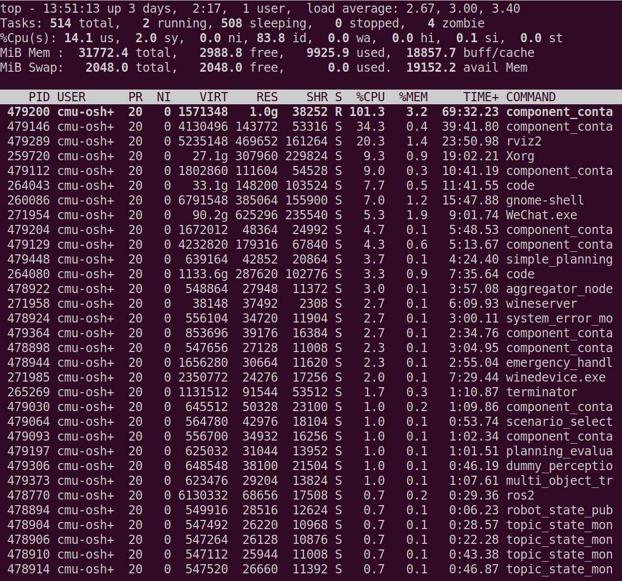
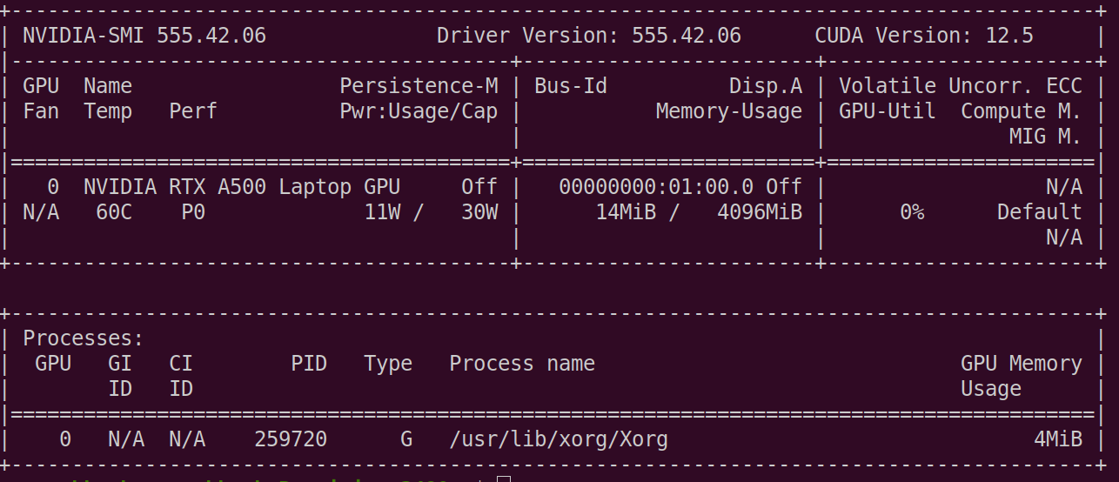
No GPU utilization
top (CPU utilization)
nvidia-smi (GPU utilization)

Slide 6
Possible Reasons
Integrated GPU
Rviz
  sudo prime-select nvidia
  weird behaviors
Power constraint

Slide 7
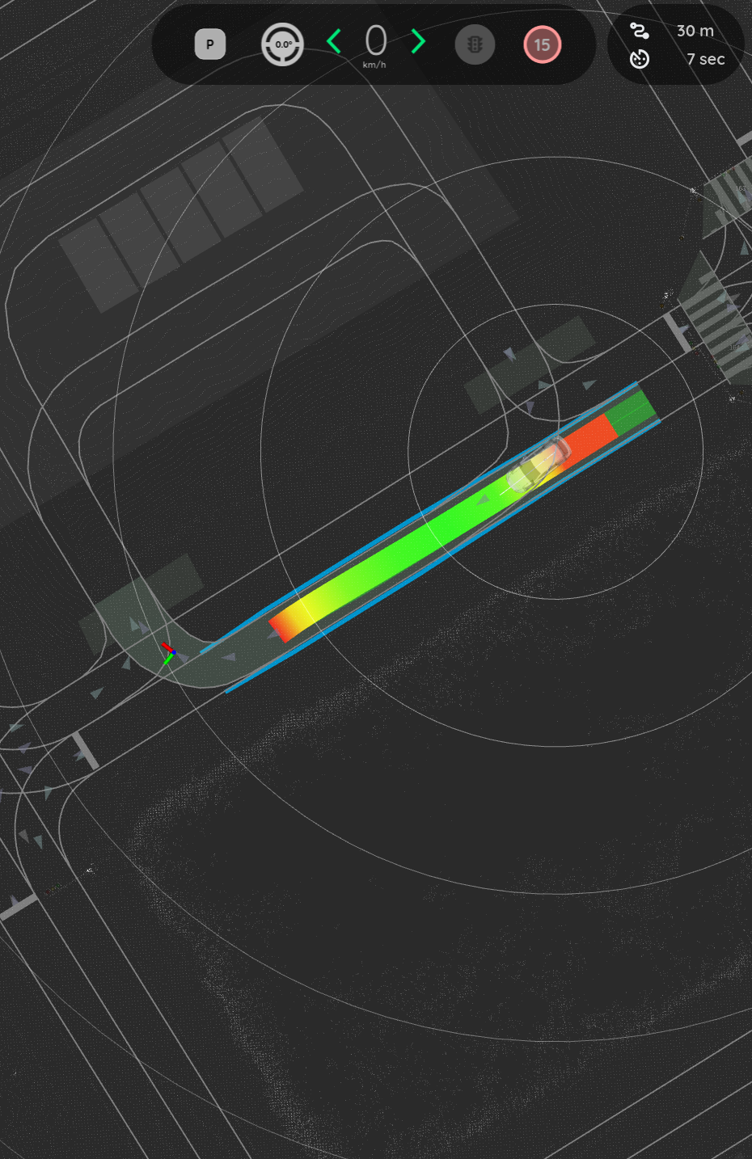
Resolving Planning Issues
autoware_behavior_path_planner relies on “Behavior Trees”
Behavior trees not present in newer version
Must rebuild without dependency to resolve

Slide 8
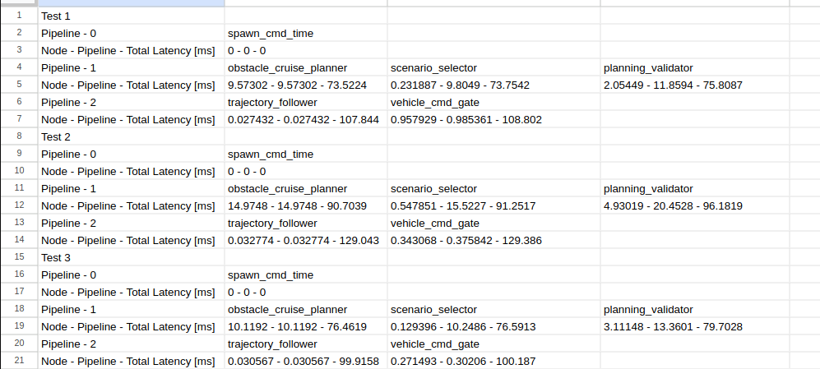
Reaction Time Results (Example)

Slide 9
Ongoing Tasks
Understand topic outputs and reaction analyzer data
Migrate all the script and analyzer to ambarella
Use CVFlow to benchmark example CV model performance and hardware requirements on Ambarella

